Slide 1
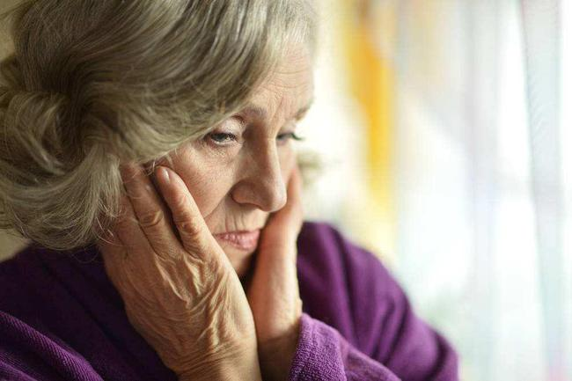


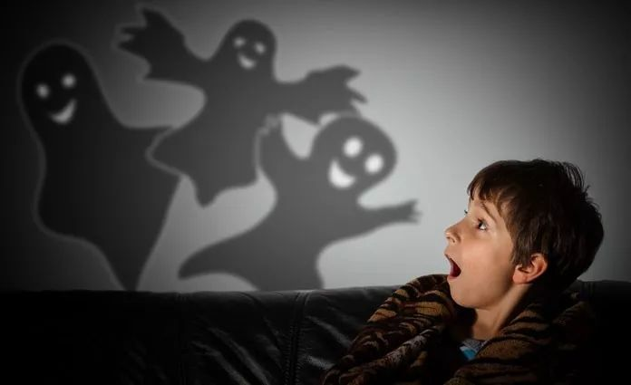
The Certainty of Fear
Audra Kendall

Slide 2
Detailed Understanding of the Text
1. I dreaded that someday when my mother was distracted, Crazy Betty (our local small-town oddball) would grab me in the grocery store. On the hottest summer nights, my feet had to be wrapped tightly in my bedsheets; if one of them hung bare over the side of the bed, who knew what might grab it in its cold, slimy claw? (Para. 1)
►Please translate the sentences into Chinese.

Slide 3
Detailed Understanding of the Text
2. But all other frights paled before the Great Fear, the Titanic of my childhood terrors. (Para. 1)
►Please paraphrase the sentence in English.

Slide 4
Detailed Understanding of the Text
3. Looking at Monk-Monk today, you wouldn’t see what I see. You’d see a torn, discolored sock monkey, very much past his prime, stuffing leaking from his stumpy tail, holes on his sock-body inexpertly stitched up with thread that doesn’t match. (Para. 3)
►Please translate the sentences into Chinese.

Slide 5
Detailed Understanding of the Text
4. I see my dearest childhood friend, my companion of a thousand nights. When I was only two and very ill, an aunt made him for me and delivered him to the hospital. I bonded with him fiercely and rarely let him out of my sight. When no one else was around, Monk-Monk played endless games with me, soaked up my tears, and listened to my secrets. (Para. 3)
►Please explain the reddened words and expressions in English.

Slide 6
Detailed Understanding of the Text
5. I can hardly describe the depths of my panic. I don’t think I cried; my terror was beyond that. I could barely breathe. My thoughts raced like a wild animal in a tiny cage. (Para. 5)
►Please paraphrase the sentences in English.

Slide 7
Detailed Understanding of the Text
6. Was Monk-Monk lying in a weedy strip along the interstate, lonely and cold, never to be loved again? (Para. 5)
►Please explain the reddened words in English.

Slide 8
Detailed Understanding of the Text
7. When we found Monk-Monk wedged behind the sofa (could Uncle Ken really have been mean enough to do that? I never found out), I was limp with relief. For days afterwards I was shaken, crying at the least provocation. (Para. 6)
►Please translate the paragraph into Chinese.

Slide 9
Detailed Understanding of the Text
8. They will risk almost anything in order to maintain the illusion that they are cool, composed and in control. (Para. 8)
►Please translate the sentence into Chinese.
►What grammatical function does that-clause serve here?

Slide 10
Detailed Understanding of the Text
9. The excited boys arrived at the airport and checked in. After sitting down to wait for their flight, one nudged the other. “Look at the tickets,” he told his brother. “They don’t say ‘Florence.’” Indeed, the tickets did not list Florence as the destination. (Para. 9)
►Please explain the reddened words and expressions in English.

Slide 11
Detailed Understanding of the Text
10. The fear of being conspicuous does not usually land teenagers on jet airplanes bound for unknown destinations. But for many adolescents, it rules their daily lives. Such fear is rooted in the enormous self-consciousness that afflicts many adolescents. Psychologist David Elkind has come up with what he calls the “Imaginary Audience Theory” to help explain this period of life. (Para. 14)
►Please translate the paragraph into Chinese.

Slide 12
Detailed Understanding of the Text
11. As a result, the adolescent is terrified of doing or saying something that will attract scorn or criticism. As a result, we end up with the teenager whose life is “ruined” by an outbreak of acne; an adolescent who won’t leave the house on a bad hair day, or the teen who refuses to return to school after making an embarrassing slip during a speech. (Para. 15)
►Please translate the sentences into Chinese.

Slide 13
Detailed Understanding of the Text
12. Adolescents can be so fearful of being criticized that they sometimes go along with the crowd when it is in their best interests not to. Teens get into cars with obviously intoxicated drivers; they go along with the crowd on a shoplifting expedition; they engage in risky sexual behavior, etc., in large part because they are afraid to speak up and risk the scorn of the “audience.” (Para. 16)
►Translate the sentences into Chinese.

Slide 14
Detailed Understanding of the Text
13. The key word here is “middle.” As people enter middle age, they face the unsettling fact that their lives are halfway over. They are no longer youngsters, looking ahead at decades filled with unlimited potential. In looking back at what they have accomplished, many people feel unsatisfied. (Para. 18)
►Please explain the reddened words in English.

Slide 15
Detailed Understanding of the Text
14. They become critical of their own aging bodies. As their parents die and their children grow up and leave home, they feel adrift, no longer certain of their roles in life. Frightening thoughts press in: “My life is heading downhill. I’m running out of time.” (Para. 18)
►Please translate the sentences into Chinese.

Slide 16
Detailed Understanding of the Text
15. The result of all this inner turmoil is what is often termed a midlife crisis. Movies and sitcoms often present such a crisis in tragicomic style: the middle-aged guy dumps his wife, dyes his hair, buys a sports car, and begins romancing a woman young enough to be his daughter. The middle-aged woman gets liposuction and a facelift and has an affair with a young personal trainer. (Para. 19)
►Please translate the paragraph into Chinese.

Slide 17
Detailed Understanding of the Text
16. Many long-term marriages break up as a result of one or both partners’ midlife crisis. The panicky feelings that can result from thinking “Is this all there is?” can make even a formerly happy marriage seem suffocating. (Para. 20)
►Please translate the sentences into Chinese.

Slide 18
Detailed Understanding of the Text
17. However, most midlife crises do not have such dramatic results. More typically, the midlife crisis is a time of inner exploration, of reconsidering one’s priorities. It may involve a period of depression, but, fortunately, most people emerge from a midlife crisis feeling relatively satisfied. They come to terms with the idea that youth and its promise are behind them, and learn to appreciate the perhaps quieter joys of mature life. (Para. 21)
►Explain the reddened words and expressions in English.

Slide 19
Detailed Understanding of the Text
18. Senior citizens self-knowledge often allows them to state their opinions and explore new interests in a way they did not feel free to in their younger years. (Para. 22)
►Please translate the sentence into Chinese.

Slide 20
Detailed Understanding of the Text
19. Afraid of being hurt, they become hermit-like, staying within the confines of their homes. Ironically, this isolation and lack of exercise can actually hasten the dreaded loss of independence. Mental and physical activity are both key elements in keeping elderly people in good health. (Para. 25)
►Translate the sentences into Chinese.

Slide 21
Detailed Understanding of the Text
20. Every stage of life brings them; while we may say goodbye to childish fears, there are always others in the wings, waiting to take their place. By being aware of them, we can keep their dark shadows from adversely affecting our lives. (Para. 26)
►Explain the reddened words and phrases in English.

